Slide 1

|
CREATING CUSTOM PLUGINS
JANE DOE | @janedoetweets | #PLAY2018
Notes:
Important Notes:
Please try to work titles so that they can be action oriented/concise which fit best within our template layout.
Ie. Instead of saying:
Recharging employee culture through communication. (which would be too much in the all caps usage)
Try:
Let’s talk culture. (in all caps main head 26 character count with spaces and period)
Employee engagement and communication. (in all caps sub head 38 character count with spaces and period)
Or instead of saying:
Account-Based Marketing in Action.
Driving success & revenue with ABM.
Try:
ABM success in action. (in all caps main head 26 character count with spaces and period)
Drive roi with account based marketing. (in all caps subhead 38 character count with spaces and period)

Slide 2
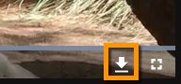
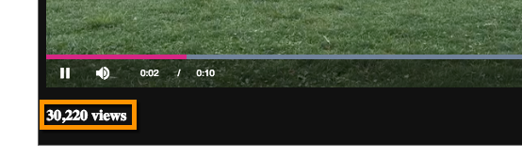
EXAMPLE CUSTOM PLUGINS
Download video plugin
All time video views

Slide 3
MATTHEW BOLES
LEARNING SPECIALIST
BRIGHTCOVE INC.
mboles@brigthcove.com

Slide 4

WHAT YOU WILL LEARN
Use cases for using custom plugins
Plugin development workflow
Plugin syntax
‘Packaging’ plugins
Plugin generator overview
OBJECTIVES

Slide 5
USE CASES FOR CUSTOM PLUGINS
Notes:
Important Notes:
Section title is in all caps and you have a MAX 25 character count per line including spaces and period
Please also include icon play branding in exact location of lower right

Slide 6
WHY USE CUSTOM PLUGINS
USE PLUGINS TO
Modify default behavior
Add functionality
Customize appearance
CREATE CODE THAT IS EASILY REUSEABLE
Modify default behavior
Add functionality
USE WITH BOTH STANDARD AND ADVANCED PLAYER CODE

Slide 7
SUGGESTED PLUGIN DEVELOPMENT WORKFLOW
Notes:
Important Notes:
Section title is in all caps and you have a MAX 25 character count per line including spaces and period
Please also include icon play branding in exact location of lower right

Slide 8
Develop JavaScript/CSS in one page with an in-page player implementation
Move the JavaScript/CSS to local files
Move JavaScript/CSS to Internet accessible locations
…
DEVELOPMENT WORKFLOW

Slide 9
EAMPLE CODE
videojs.registerPlugin('liveCustomError', function() {
var myPlayer = this,
// Initialize boolean variable so overlay not shown be default
showOverlay = false;

Slide 10
WHAT YOU HAVE LEARNED
Why use custom plugins
A best practice development workflow
Plugin syntax
How to implement your pluguins

Slide 11
Q & A

Slide 12
|
YOUR LOGO
THANK YOU!
JANE DOE | @janedoetweets | #PLAY2018

